Slide 1
Customer Retention
E-retail factors for customer activation and retention: A case study from Indian e-commerce customers

Slide 2
Abstract
Customer satisfaction has emerged as one of the most important factors that guarantee the success of online store; it has been posited as a key stimulant of purchase, repurchase intentions and customer loyalty. A comprehensive review of the literature, theories and models have been carried out to propose the models for customer activation and customer retention.
Five major factors that contributed to the success of an e-commerce store have been identified as: service quality, system quality, information quality, trust and net benefit. The research furthermore investigated the factors that influence the online customers repeat purchase intention on the basis of the Means End Chain theory (MEC) and Prospect theory.
By hypothesising that a combination of both utilitarian value and hedonistic values are needed to affect the repeat purchase intention (loyalty) positively, Structural equation model has been presented on the primary data collected from the Indian online shoppers. Results indicate the e-retail success factors, which are very much critical for customer satisfaction. By increasing the utilitarian value and hedonistic values derived by the customers, customer satisfaction and hence the customers repeat purchase intention can be increased significantly.

Slide 3
Difference between Hedonistic values and Utilitarian values
Hedonistic value | Utilitarian value
Hedonic Value can be defined as the immediate psychological gratification that comes from experiencing some activity or from consumption of a product. Purchasing makes the person feel happy or Joyfulness. | Utilitarian value it can be called functional value and is associated with the functional benefits that a customer gets from a product.

Slide 4
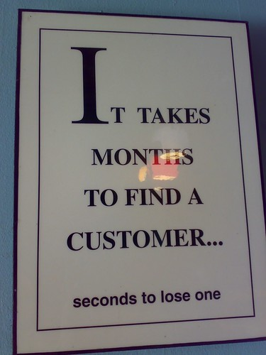
What is customer Retention?
Customer Retention is the activity that a selling organization undertakes in order to reduce customer defections. Successful customer retention starts with the first contact an organization has with a customer and continues throughout the entire lifetime of a relationship.
A company’s ability to attract and retain new customers, is not only related to its product or services, but strongly related to the way it services its existing customers and the reputation it creates within and across the marketplace.

Slide 5

What is Ecommerce?
Ecommerce, also known as electronic commerce or internet commerce, refers to buying and selling of goods or services using the internet, and the transfer of money and data to execute these transactions.
Ecommerce is often used to refer to the sale of physical products online, but it can also describe any kind of commercial transaction that is facilitated through the internet.

Slide 6
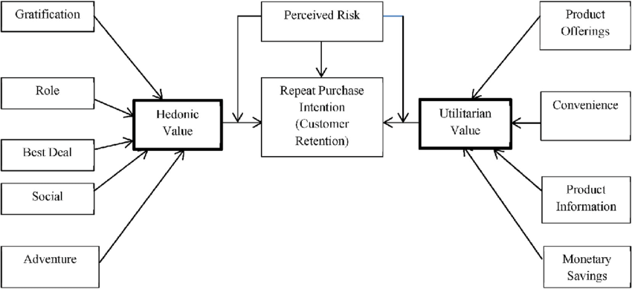
Problem Statement
Our Problem is all about finding the success rate of the E-retailers on selling their Goods. Which depends on purchase, repurchase intentions and customer loyalty. There are five major factors which tells the success rate of ecommerce are service quality, system quality, information quality, trust and net benefit. After many trails they found that, customer retention depends on the combination of both utilitarian value and hedonistic values which are needed to affect the repeat purchase intention positively. By increasing the utilitarian value and hedonistic values, which are derived by the customers, customer satisfaction. Hence the customers repeat purchase intention can be increased significantly.

Slide 7
Findings From the dataset
There are 71 columns in the dataset, which tells about pros and cons of the Indian online retailers. The columns are all about the customers personal details like their gender, age, which device they use to shop, how often they shop online, since how many years they are shopping online, Weather they make purchases for benefits or for satisfaction, the pros and cons of different websites etc.
Companies are able to yield higher profits by maintaining loyal customers. These customers make more frequent purchases and spend large in every transaction with their brand. Business find it easier in up-selling and cross-selling its products to group of loyal customers. Once people are satisfied with the services of particular brand; they like to explore more of its stuff. Customer don’t go for much analysis and comparison of brand products while making purchase decisions if they are assured of its quality.
All we need to find is which retailers are leading in the industry by making Assumptions . After all findings I found that Amazon is the best leading online Retailer store where it is meeting the expectations of the customers , and making the customers .

Slide 8
Exploratory Data Analysis Steps
Our dataset consists of categorical columns . So I have used count plots and bar graphs to visualize the data.
A female from Noida with age group in between 21-30 she shops online usually.
She is a customer more than 4 years and in last year she purchased less than 10 products from online . she usually uses a smart phone with mobile internet for logging into the website to shop. She uses google chrome as a source to login into the website. she uses windows mobile with screen size more than 5 inches. From the search engine channel she logged in to the website for first time after that she used direct URL to shop online . Everyday she spends 15 minutes of time on searching for the products . Sometimes she quit out if she is not sure with the product . She uses credit card for making online payments. Sometimes if she get better alternative
she quits this and go purchase in the other store. In order to buy a product a particular website must give the complete information about the seller and the product information then only we can compare the product cost there details in different websites and we tend to buy that particular product in a particular website. We should be able to navigate the website easily and the products information in the website much be clearly stated their uses , lifetime etc . Then only we more tend to buy those products and can shop easily .

Slide 9
EDA Steps
We strongly agree with the user friendly interface of the website which can be easily processed and the websites loading and processing speed must be very fast then only we feel like buying the products otherwise in this busy world we don’t spend that time on wasting for that website rather we get from the other website.
So we tend to go for other options. The websites must provide the all the possible ways of payment methods then only the customers shop frequently all the time the mode of the payment for customers may not possible sometimes they may choose cash on delivery . So if the retailers provides all type of payment methods then the sales increases . And the transaction also must be given with some stipulated time otherwise the payments may be failed so they has to provide minimum amount of time which need to be fixed for all.
There should be all best possible ways to communicate with customers for knowing the details of the product which they have purchased , like asking for their service , rating for the product, reviews etc . Once in every purchase the online retailers have to communicate with customers using different socials platforms and know their services . How best they are fit in selling . And the retailers also has to give as best as they provide the discounts compared to other stores then only their sales increases . Because most of the customers they we will comparing the prices of the product in different stores . Where there is more discount there they tend to shop so the retailers must check and try to give for as less as possible . Then only customer retention increases.

Slide 10
EDA Steps
Some people for enjoyment they shop online which means they are found of different varieties they are termed to be hedonistic . Which means they feel good on shopping online . They feel shopping online is more convenient and flexible . They contributes much for the retailers by buying all the costly products . Mostly they don’t see for discounts and all they buy randomly.
Loyalty programs are used in almost every industry imaginable, and they’re certainly used in the retail industry. Loyalty programs are encourage increased spending from consumers, promote increased brand awareness and PR, and reward loyal consumers with discounts and gifts and in the retail industry there should be return and replacement policy then only if the product is damaged or something then customers buy with trust in online products . We strongly agree with that.
By giving discounts and many other benefits like on purchase giving gift cards , providing free shipping and cash on delivery to the customers Amazon will speed up to clear all products . By conducting some big sails like amazon prime day , summer sail , fab phone feast etc...And end up there sails and get the new products according to| the trend and attract customers.

Slide 11
EDA Steps
Amazon and Flipkart accepts different mode of payments like credit and debit cards. Credit cards currently accepted include Visa, Mastercard, Discover, American Express, Diners Club, and JCB . and they also provide cash on delivery option too .
Amazon is only the website which has fastest delivery . They can even deliver with in a day by charging some extra amount . Amazon never shares the information like login , there purchase history, their mode of payment or any other details of customers with any other .They maintain (privacy) everything secrete. Amazon provides the best website when it comes with security reason amazon keeps all the customers details private . They never share any type of details of the customers with any other.
We can trust amazon in buying the products they also provide return options if we don’t like the product we can return the product even on less worth products also they keep return options . So amazon is the website which we can trust on buying. The website which is as efficient as of before is amazon.
I suggest Amazon.com as a best Indian online retailer store for purchasing all the essential goods.

Slide 12
Assumptions
Retail industry in India has emerged as one of the most dynamic and fast-paced industries. India is the fifth-largest global destination in the retail. India has replaced China as the most promising markets for retail expansion, supported by expanding economy. India is expected to become the world’s fastest growing e-commerce market, in the sector and rapid increase in the number of internet users. Various agencies have high expectations about growth of Indian e-commerce markets. E-commerce is expanding steadily in the country. Customers have increasing choice of products at the competitive rates.
Companies are able to yield higher profits by maintaining loyal customers. These customers make more frequent purchases and spend large in every transaction with their brand. Business to find it easier in up-selling and cross-selling its products to group of loyal customers. Once people are satisfied with the services of particular brand; they like to explore more of its stuff. Customer don’t go for much analysis and comparison of brand products while making purchase decisions if they are assured of its quality.
Our India is also experiencing the pandemic situation covid19 with this also all the offline stores were shut. So with this also all the people are tending for online . And the online retailers also taking the chance to attract the customers by giving different types of benefits like all modes of payments , discounts , return on exchange for free of cost etc. So with this also our India leading 5th position on online purchases.
C

Slide 13
Recommendations
Online retailers should consider above factors identified while designing the online retailing strategy. Customers will get irritated if website response is slow. So, website and products should be easily seen on the website. Assurance of online financial transaction and confidentiality of data is also very important factor for customers Proper policy statements and secure payment gateways should be visible while transactions are done. In case of problems, staff should be easily accessible. Actual service should also be provided right the first time itself. It is recommended that online retailers should give importance to above factors to remain competitive in the market. As the customers are more vulnerable to marketing campaigns, they can easily be lured by new offers by the competition. As comparing with the other store they have attract the customers by providing many benefits and everyday they have to change as per the trend and meet the levels of expectations of the customers.

Slide 14
Advantages of Customer Retention
Cheaper than Acquisition: Foremost advantage of customer retention for every organization is that saves the cost involved in acquiring new customers. ...
Loyal customers yield higher profits: Companies are able to yield higher profits by maintaining loyal customers.
More word of mouth referrals: Customer retention enable companies in getting large amount of referrals easily.
Easy up-selling and cross-selling: Business find it easier in up-selling and cross-selling its products to group of loyal customers.
Loyal customers are more forgiving: Another major advantage of customer retention is that it enables in getting better co-operation from people.
Better communication with customers: Customer retention is an effective tool available to business for establishing proper communication network with customer.

Slide 15
Disadvantages of Customer Retention
Large investment in terms of price and time: Customer retention can prove expensive for business in the way that it involves large investment both in terms of price and time. It requires huge cost for running loyalty programs in order to retain customers for a longer period. Business need to sacrifice their profit by offering several discount and cashback offers to its audience.
Require concerted commitment and Business Culture: Every business organization for attaining better customer retention rate should ensure a concerted commitment and proper culture. Every member working at distinct hierarchy of organization should focuses on providing best services to their customers.
New customers may be overlooked: Organization making efforts for attaining efficient customer retention rate may not focus on needs of new customers. There may be chances of new clients being overlooked by brand in a hoard to satisfy its existing customers. Unsatisfied customers may spread negative piece of information about the brand in society.

Slide 16

Conclusions

